Slide 1
Video Surveillance with MOTION AND Face DETECTION
Alec wiese and Rakhee bhojakar
ECE 510, embedded vision
Dr. hammerstrom, Portland state university

Slide 2
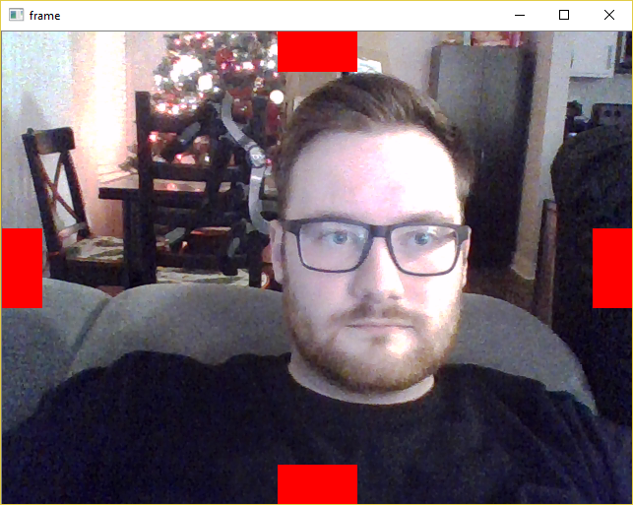
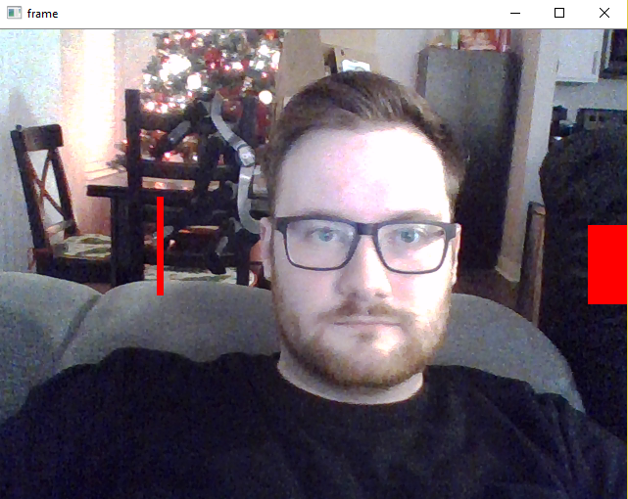
Select REGION of VIDEO to OBSERVE

Slide 3
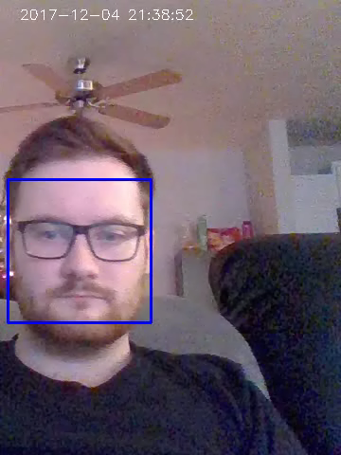
VIDEO is cropped and will detect motion, people AND FACE

Slide 4
Flow chart
If face detected
If either is true
Input image (cropped)
Background subtraction
Run face detection
If contour is large and tall
Grayscale
Threshold
Run Contour detection
Save face or frame as image
Upload frame and face to Dropbox
Gaussian blur to remove noise

Slide 5
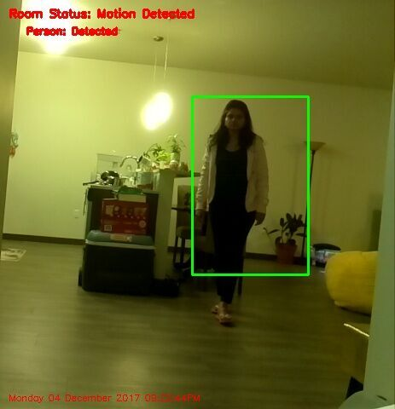
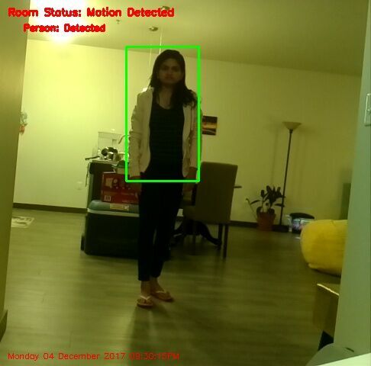
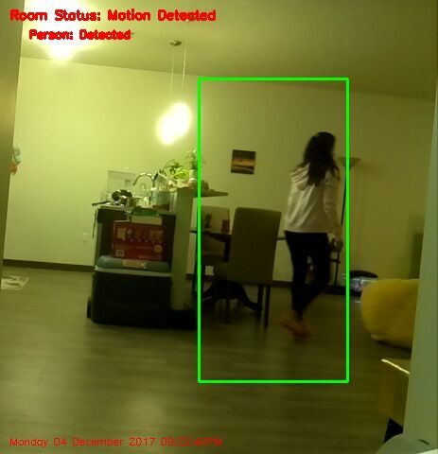
PERSON DTECTED AND SAVED TO DROPBOX

Slide 6





Faces DETECTED AND SAVED TO DROPBOX

